Slide 1
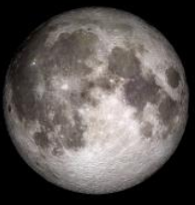
Darkside of the Moon
Group 3
Yosief, Andrew, Ben, Ellen, Jason K., Josh, Marshal, Nobon, & Sajita

Slide 2
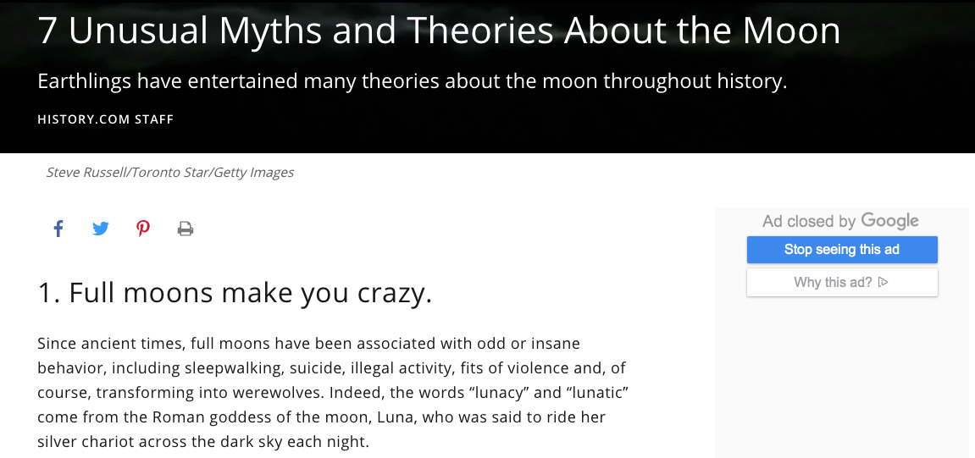
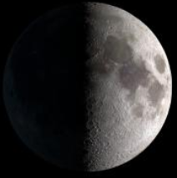
Motivation & Summary
Well, according to History.com...
https://www.history.com/news/7-unusual-myths-and-theories-about-the-moon

Slide 3
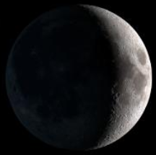
Motivation & Summary
We thought we’d test that theory by looking at EMS calls relative to the moon phases in NYC
Our Questions:
Do full moons correlate to an increased number of EMS calls?
Do full moons correlate to an increased severity of EMS calls?
Do any of the other phases correlate to a reduced number and a reduced severity of EMS calls?
Our Hypothesis:
When there is a full moon, the number of EMS calls and the severity of these calls will not be any different than they would otherwise be.
?

Slide 4
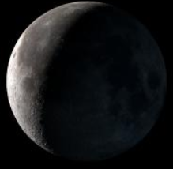
Questions & Our Data
In order to answer our questions...
We needed simplistic moon data describing when full moons were
We needed EMS data providing quantity and measurable severity of calls
Our Data
US Navy Moon Phases API (took data from 2016-2018) from NYC
Phase
Date
EMS Data CSV from NYC
Call date/time
Severity level
Response code (what was the issue appeared to be)

Slide 5
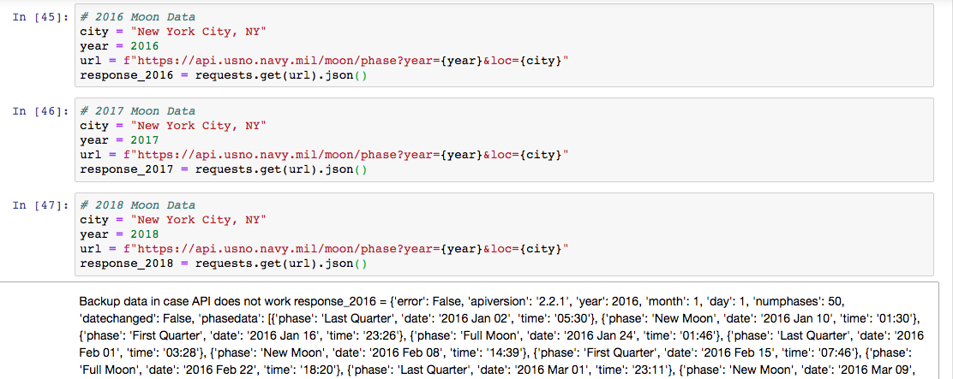
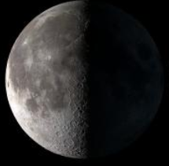
Data Cleanup & Exploration
Moon Data - Initial Import

Slide 6
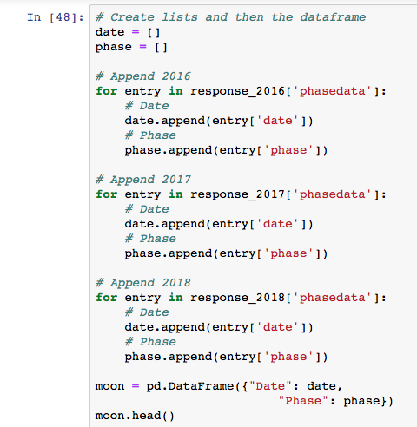
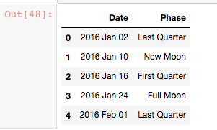
Data Cleanup & Exploration
Moon Data - Creating Dataframes

Slide 7
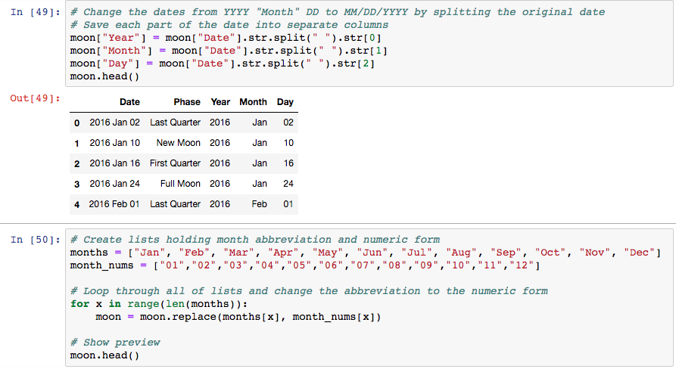
Data Cleanup & Exploration
Moon Data - Formatting Date

Slide 8
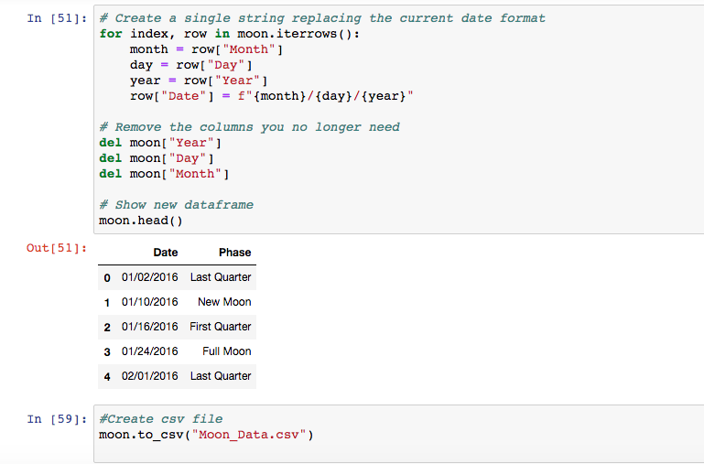
Data Cleanup & Exploration
Moon Data - Cleaning contd. & Export to CSV

Slide 9
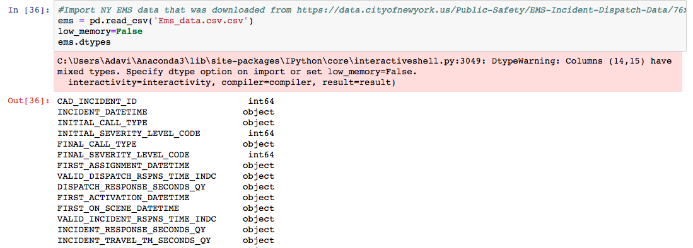
Data Cleanup & Exploration
EMS Data - Initial Import

Slide 10
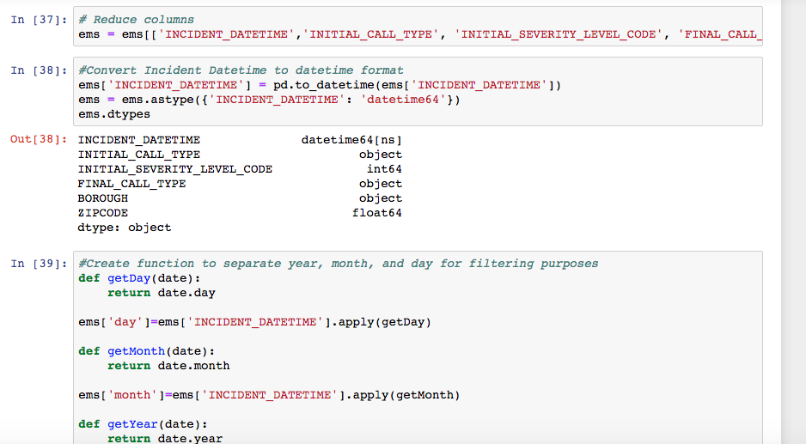
Data Cleanup & Exploration
EMS Data - Cleaning

Slide 11
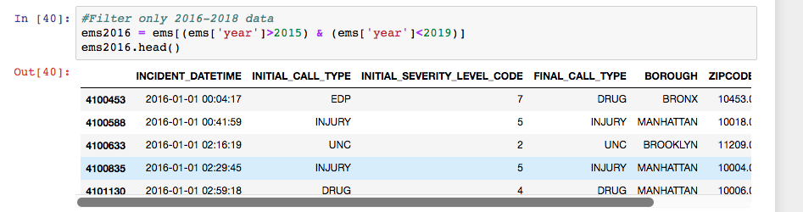
Data Cleanup & Exploration
EMS Data - Filtering

Slide 12
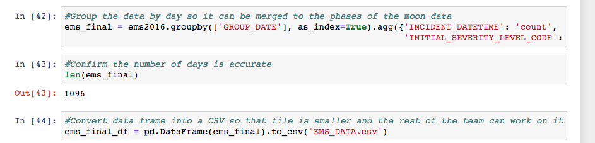
Data Cleanup & Exploration
EMS Data - Read to CSV

Slide 13
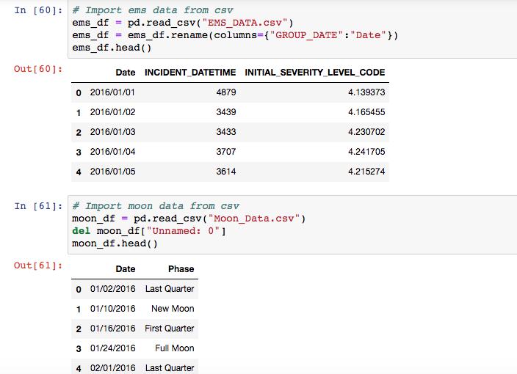
Data Cleanup & Exploration
Merging the Data

Slide 14
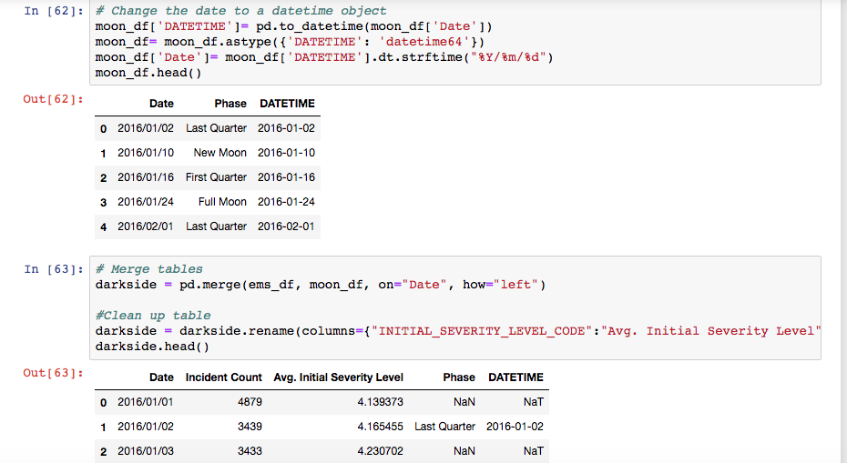
Data Cleanup & Exploration
Merging the Data

Slide 15
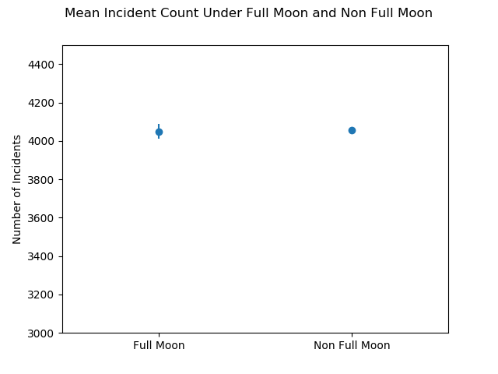
Data Analysis

Slide 16
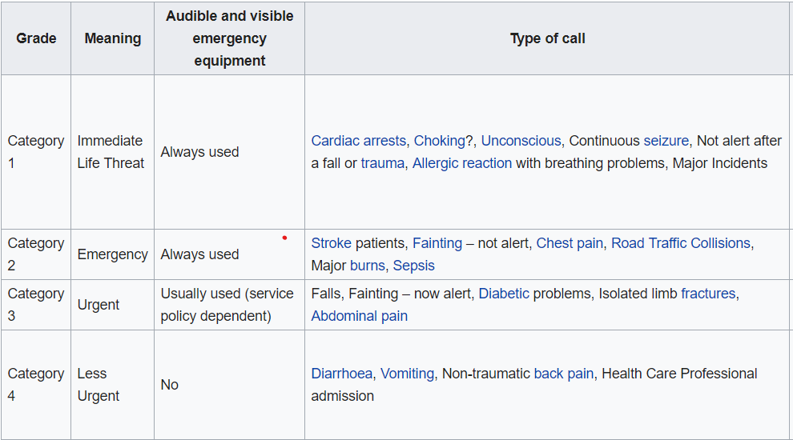

Slide 17
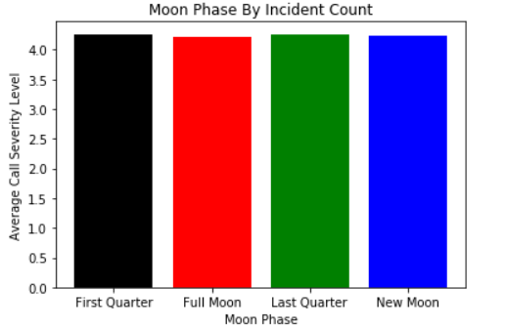
Average Severity Call By Moon Phase

Slide 18
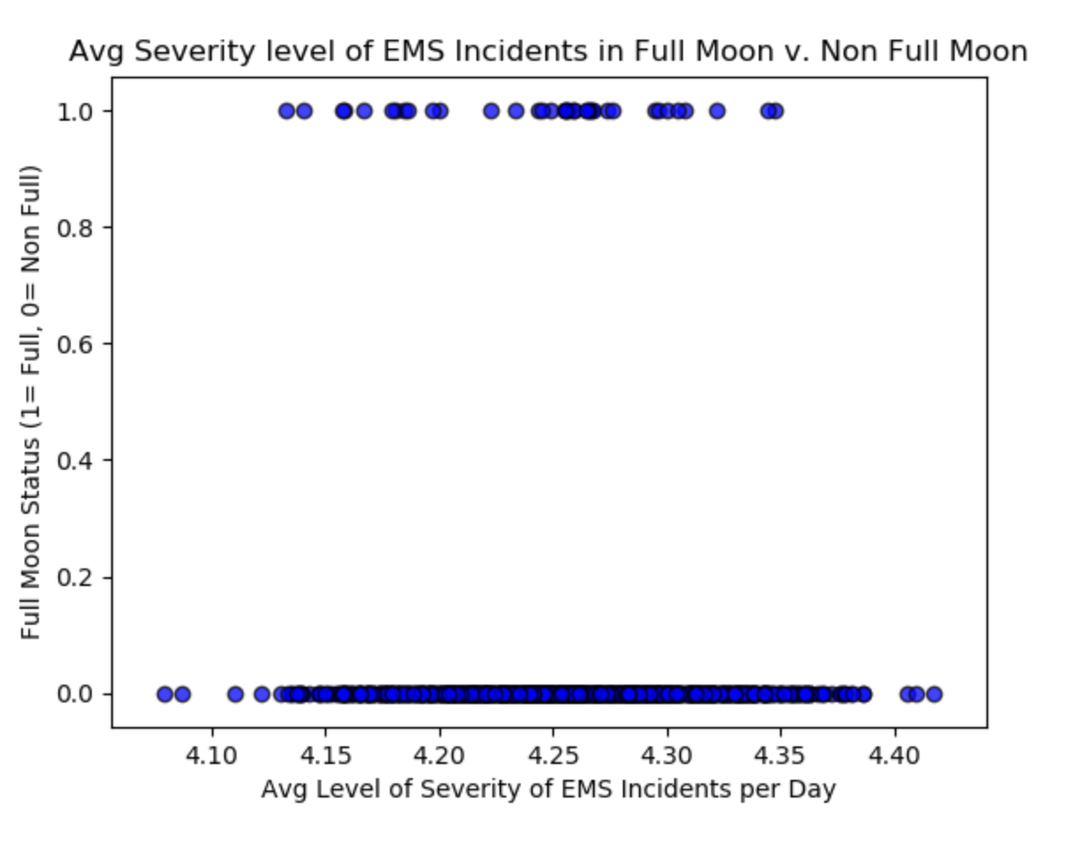
Discussion

Slide 19
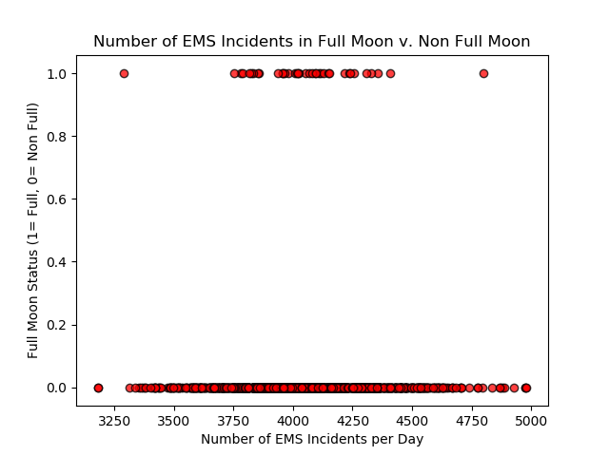
Discussion

Slide 20
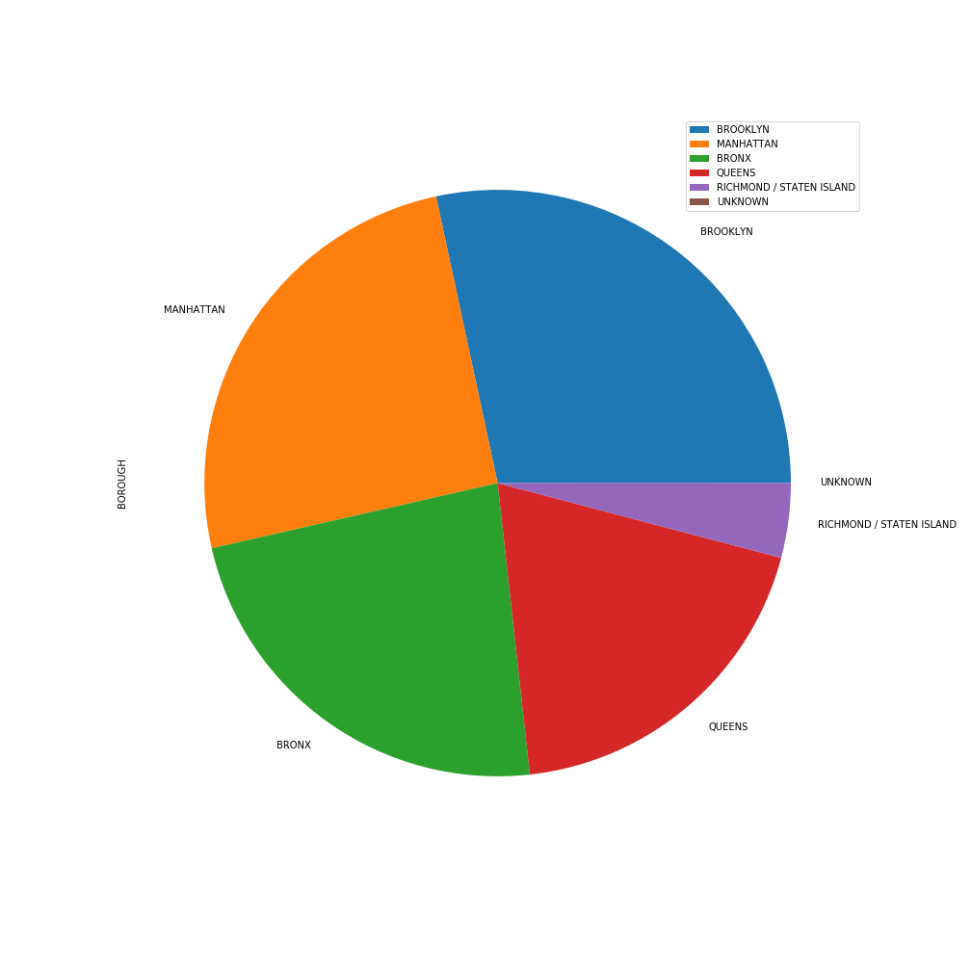
Discussion

Slide 21
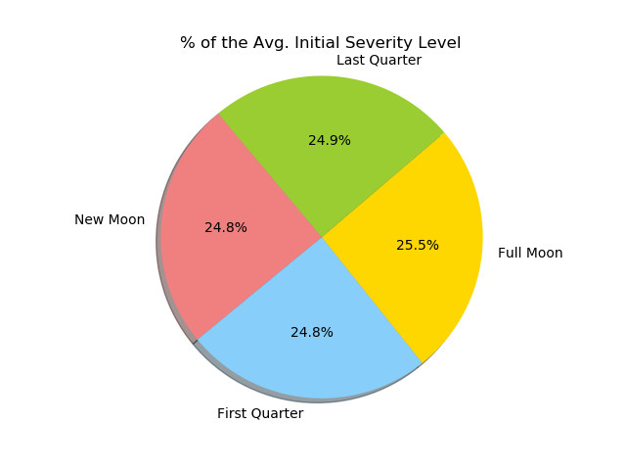
Discussion

Slide 22
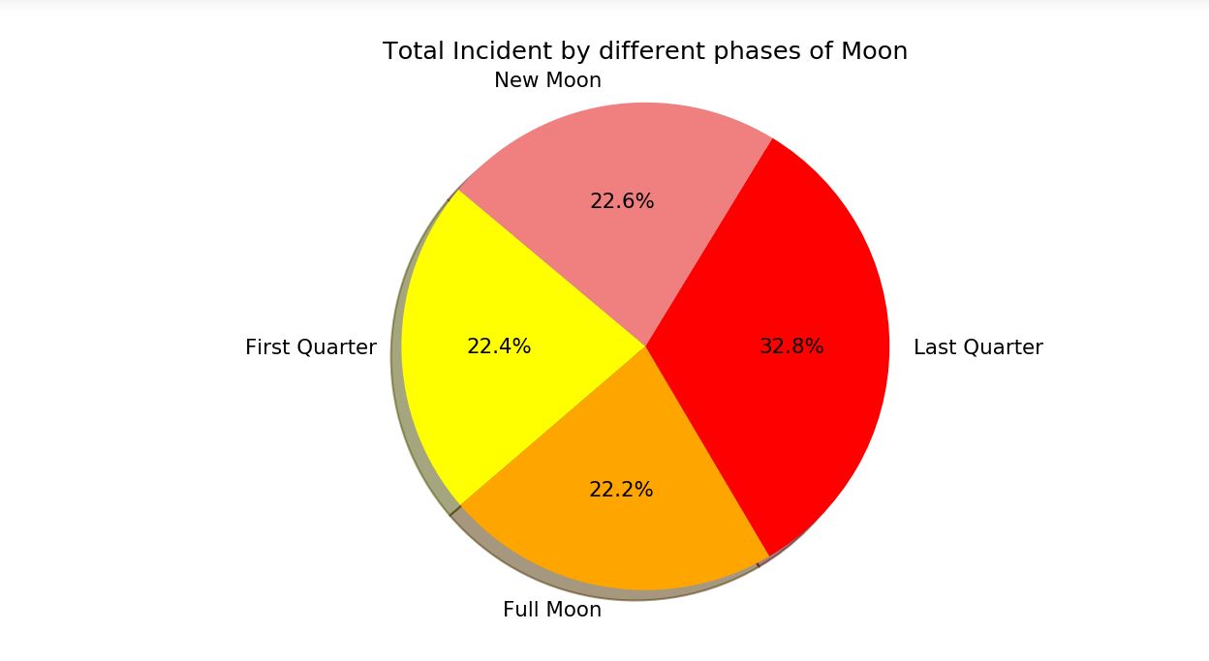
Discussion
Here we can tell that the different phases of Moon do not have the connection with the number of incident as reported in the EMS call in the New York City.
Notes:
Here we can tell that the different phases of Moon do not have the connection with the number of incident as reported in the EMS call in the New York City.
The figure shows that the incident level is high during Last Quarter which is 32.8% and it`s significant because it has the larger number of data sets in compared to any other phases.
Analysis;
Here we can tell that the different phases of Moon do not have the connection with the number of incident as reported in the EMS call in the New York City.
The figure shows that the incident level is high during Last Quarter which is 32.8% and it`s significant because it has the larger number of data sets in compared to any other phases.

Slide 23
Post Mortem
Difficulties
Large data sets… like a csv with 8.5 million rows
API’s that crash after pulling data multiple times in the same sitting
Dealing with datetimes when we just want the date to group by
What’s next?
Looking at more than just 3 years of data
Seeing if weather is a variable in this equation
Performing a similar analysis on cities elsewhere -- even worldwide

Slide 24
Questions?

